Slide 1
Learning Big Data
Aditya Konda
Big Data Engineer

Slide 2

Content
Apache Flume
Introduction
Flume Agent
Architecture
Use-Case
Benefits

Slide 3

Content
Impala
Introduction
Features
Architecture
Drawbacks

Slide 4
Flume
A tool for data ingestion.
Designed to copy streaming data to a distributed file system.
Definition:
Apache flume is a tool data ingestion mechanism for collecting aggregating and transporting large amounts of streaming data such as log files, events (etc...) from various sources to a centralized data store.

Slide 5
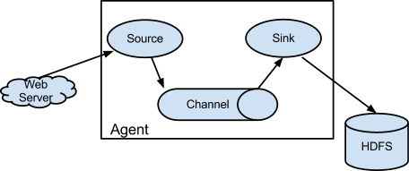
Flume Agent
Source:
receives data from the data generators and transfers it to one or more channels in the form of Flume events.
Channel:
a transient store which receives the events from the source and buffers them till they are consumed by sinks.
Sink:
stores the data into centralized stores like HBase and HDFS.

Slide 6
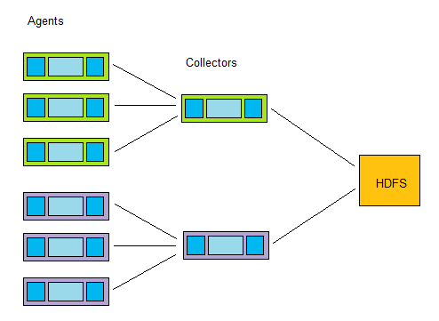
Flume Architecture

Slide 7


Flume Use-Cases
To analyze the customer behavior from a particular region.
Need to move the available log data in to hadoop for analysis.
Flume is used to move the log data generated by application servers into hdfs at a higher speed.

Slide 8
Flume – Advantages
Open source
Scaleable
Reliable
Manageable
Fault tolerant

Slide 9
Impala
An open source project developed by Cloudera.
Is a MPP (massive parallel processing) SQL query engine.
Provides high performance and low latency compared to other SQL engines for Hadoop
Provides the fastest way to access data that is stored HDFS

Slide 10
Impala
Users Can Communicate With HDFS Or Hbase Using SQL Queries.
Faster When Compared To Other SQL Engines Like Hive.
Can Read Almost All The File Formats Such As Parquet, Avro, Rcfile Used By Hadoop
Impala Is Not Based On MR Algorithms.
Implements A Distributed Architecture Based On Daemon Processes

Slide 11
Impala – Features
Supports In-memory Data Processing (I.E. Without Data Movement)
Access Data Using Impala Using SQL-like Queries
Store Data In Storage Systems Like HDFS, Apache Hbase, And Amazon S3.
Integrate Impala With Bi Tools Like Tableau, Pentaho, Micro Strategy, And Zoom Data.
Supports Various File Formats Such As, LZO, Sequence File, Avro, Rcfile, And Parquet.
Uses Metadata, ODBC Driver, And SQL Syntax From Apache Hive

Slide 12
Impala – components
Impala has three main components
Impala daemon (Impalad)
Impala state store
Impala metadata and meta store
Impala Query Processing Interfaces
Impala-shell
Hue Interface
ODBC/JDBC Drivers

Slide 13
Impala – components
Impala Daemon (Impalad)
A node where impala is installed (Impala instance)
Coordinator node processes a particular query. Any node can be a coordinator node.
Queries are processed on various impala daemon nodes.
Impala instance returns the results to the central coordinate node
Impala State Store
Checks the health of each Impalad
Updates Impala daemon health to the other daemons frequently

Slide 14
Impala – components
Impala Metadata and Meta Store
Impala uses traditional MySQL or PostgreSQL databases to store table definitions
Metadata are stored in a centralized database known as a meta store
Each Impala node caches all of the metadata locally
Impala State Store
It updates Node(Impalad) failure to other nodes(Impalad)
No other Impala daemon assigns any further queries to the affected node(Impalad)

Slide 15
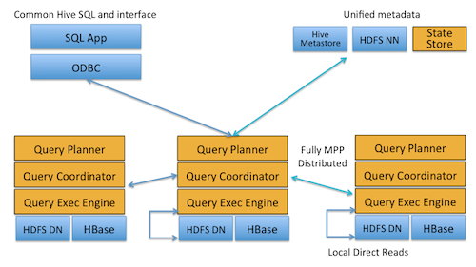
Impala – Architecture

Slide 16
Impala - Drawbacks
Does not provide any support for serialization and deserialization.
Can only read text files, not custom binary files.
Whenever new records/files are added to the data directory in hdfs, the table needs to be refreshed.

Slide 17
References
Cloudera-Impala presentations
Getting started with Impala
Impala Tutorials

Slide 18


